Slide 1



Development of Unmanned Aerial Systems (UAS) for Planetary Analog Research
Connor Williams
Dr. Christopher Hamilton (Lunar and Planetary Laboratory)
Stephen Scheidt (Lunar and Planetary Laboratory)
26th Annual Arizona Space Grant Consortium Symposium
April 22, 2017

Slide 2
Project
The goal of this project was to produce an unmanned aerial system (UAS) to study terrestrial environments that resemble Mars.
Required redesign of existing airframe to allow for portability to remote field sites.
Necessitated integration of a thermal infrared camera with a 3-axis gimbal.

Slide 3
Components
VulcanUAV Hexacopter Airframe
Forward Looking Infrared Radiometer (FLIR) A65 Camera
Raspberry Pi 3 Microcomputer
3-Axis Gimbal
Control Equipment

Slide 4
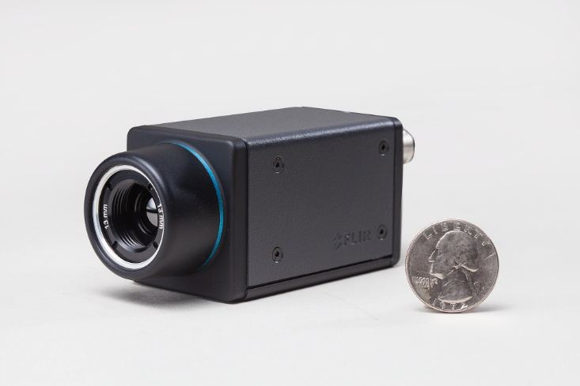
FLIR A65
Weight: 0.21 kg
IR Resolution: 640 x 512 pixels
Field of View: 25º x 20º
Data Transfer: Ethernet
Power Input: Ethernet
Source: FLIR Systems

Slide 5
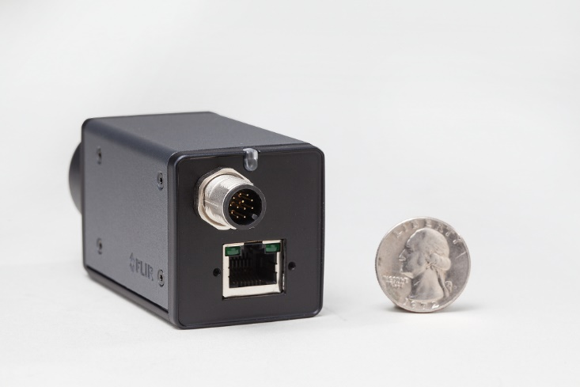
Source: FLIR Systems

Slide 6
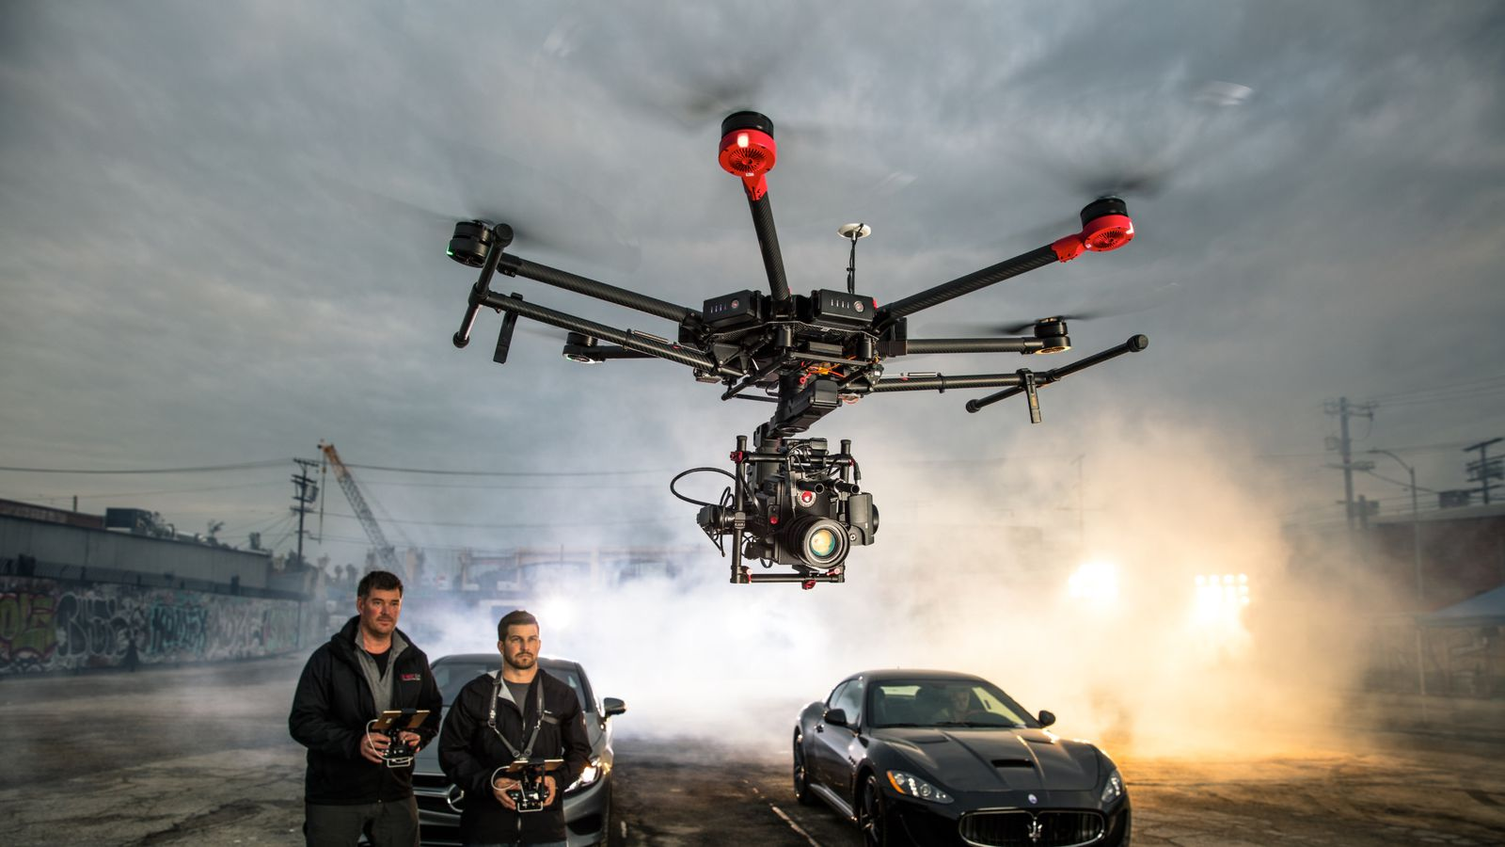
3-Axis Gimbal
Assorted makes and models available.
Must be large enough to house both the FLIR and a visual spectrum camera.
Stabilizes camera and allows for targeting of specific formations on the fly.
Source: DJI

Slide 7
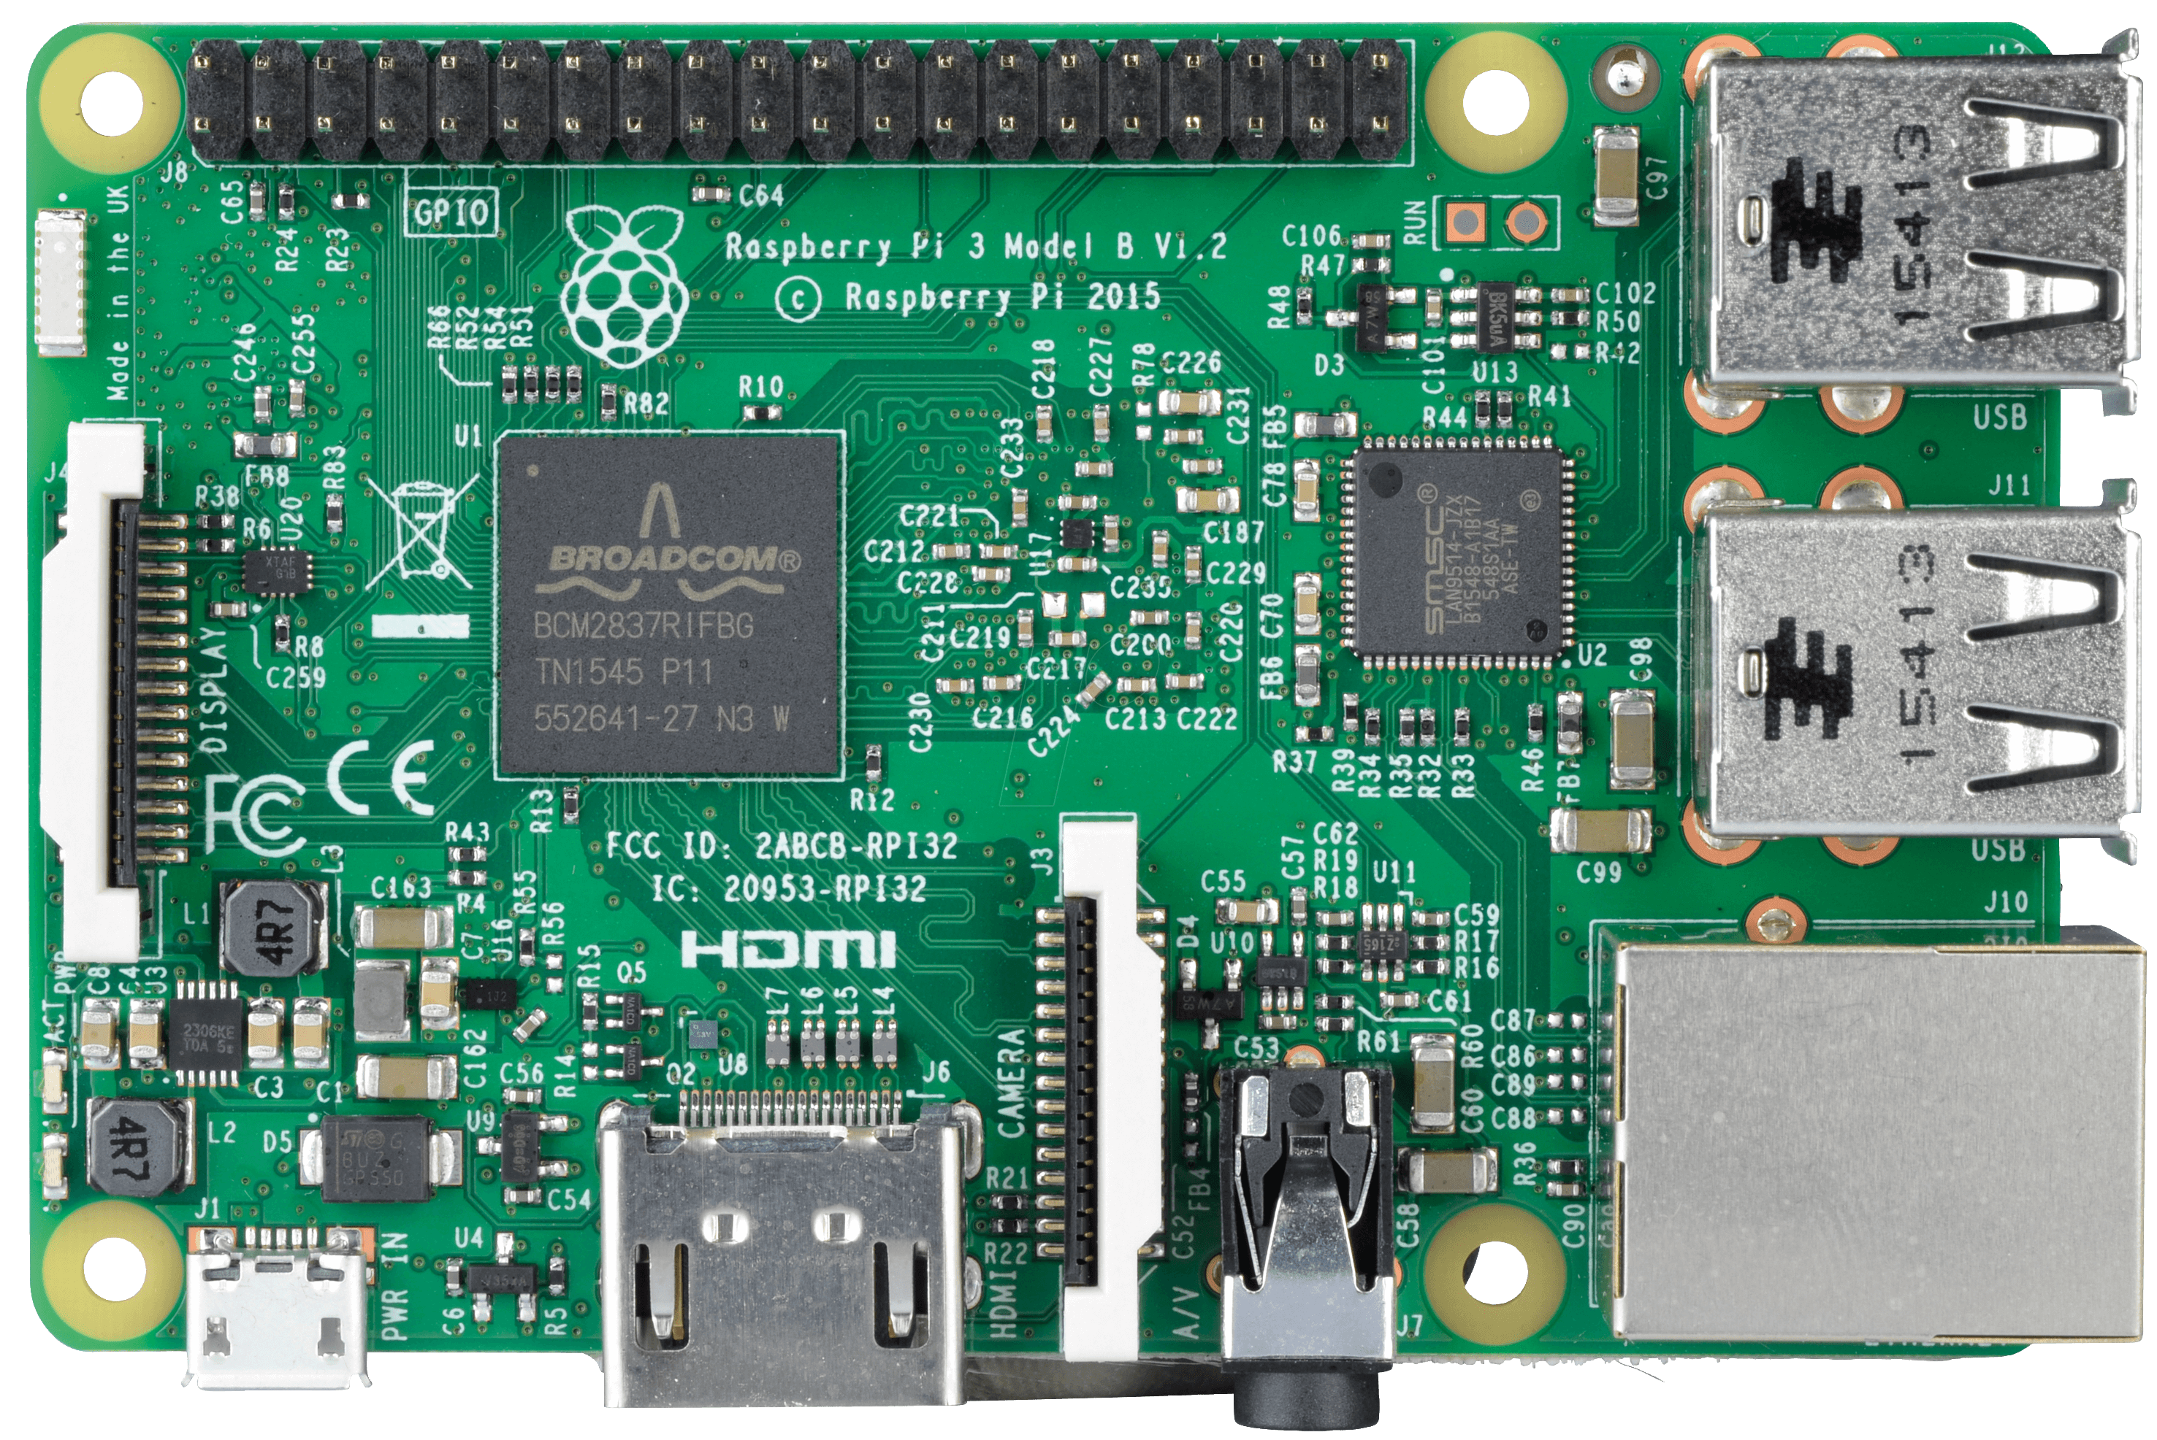
Raspberry Pi 3
Dimensions: 85mm x 58.5mm
Ports:
1x Ethernet
4x USB
1x HDMI
1x Micro USB
Programming Language: Python
Weight: 23 grams
Source: Raspberry Pi

Slide 8
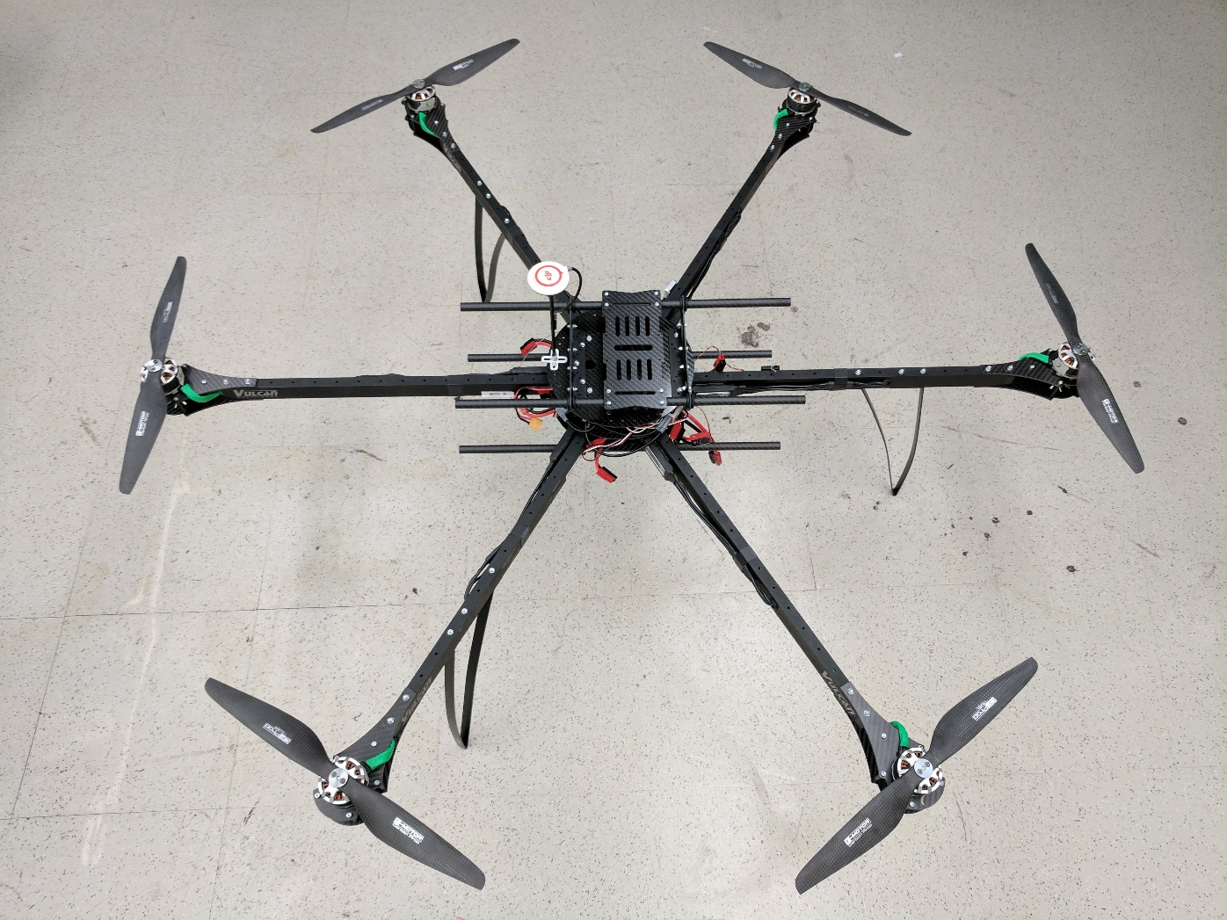
Airframe
Configuration: Hexacopter
Construction Materials: Aluminum and Carbon Fiber
Motors: 6x KDE Direct 4215XF (1.84 HP each)
Propellers: 6x T-Motor 15” Carbon Fiber
Thrust: About 24 kg total
Electronic Speed Controllers:
6x KDE Direct UAS 75HV+

Slide 9
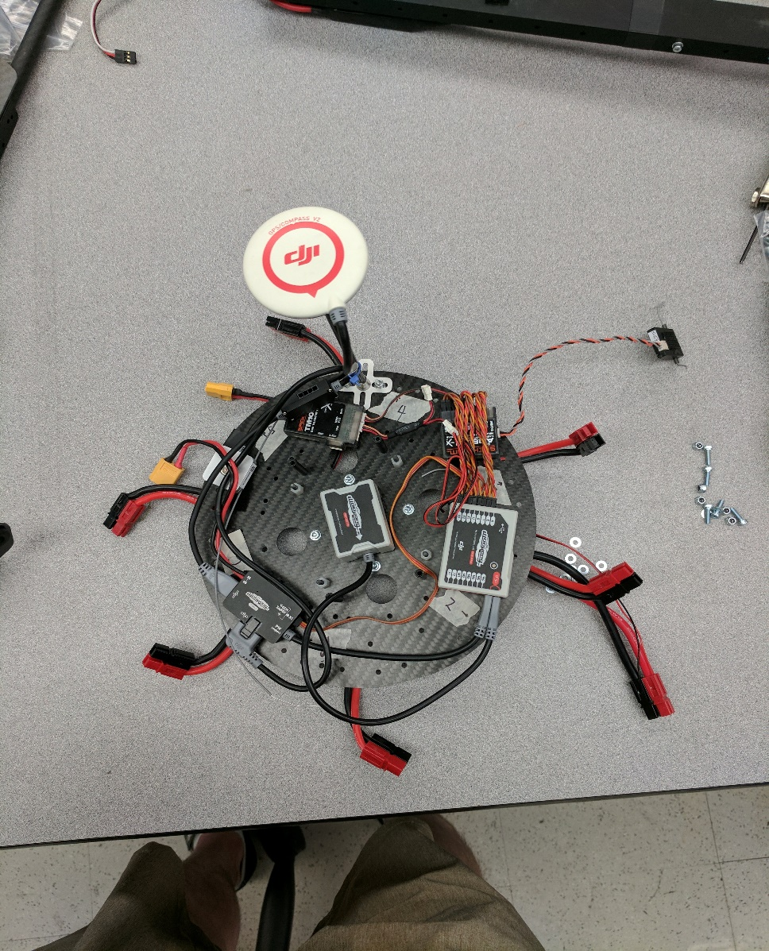
Control Equipment
DJI WooKong-M Flight Controller
Global Positioning System (GPS)
Inertial Measurement Unit (IMU)
Power Management Unit (PMU)
Spektrum DX9
Transmitter
Receiver
Distributer

Slide 10
Airframe Redesign
Requirement: Must be portable to remote field sites
(Example: Iceland).
Complete redesign of center plate was necessary.
Adjustable battery mount was installed.
Adjustable gimbal mount was installed.
Removable battery was installed.

Slide 11
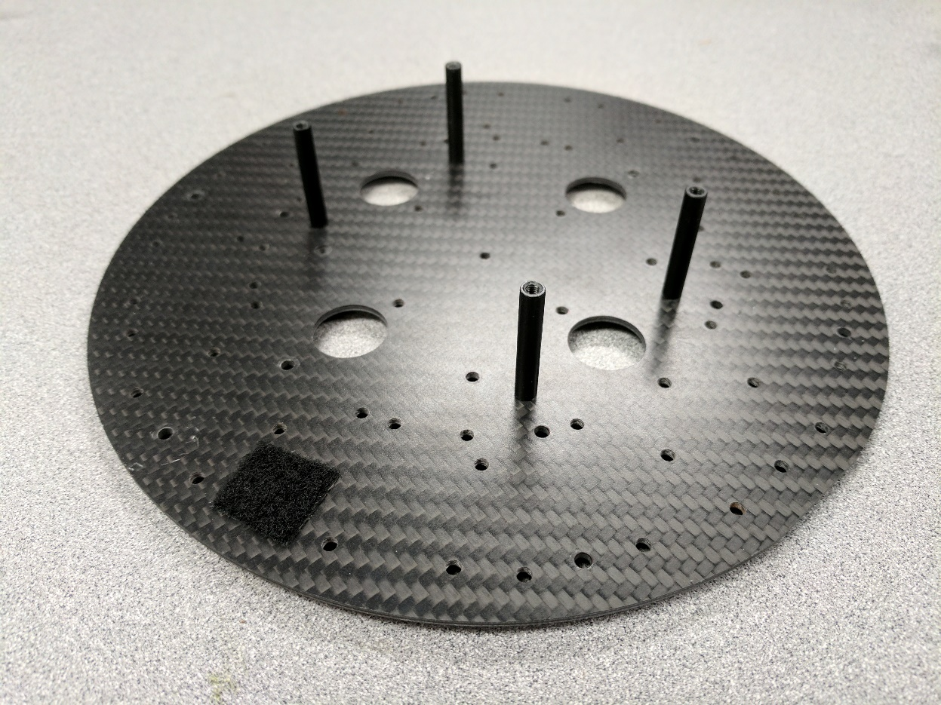
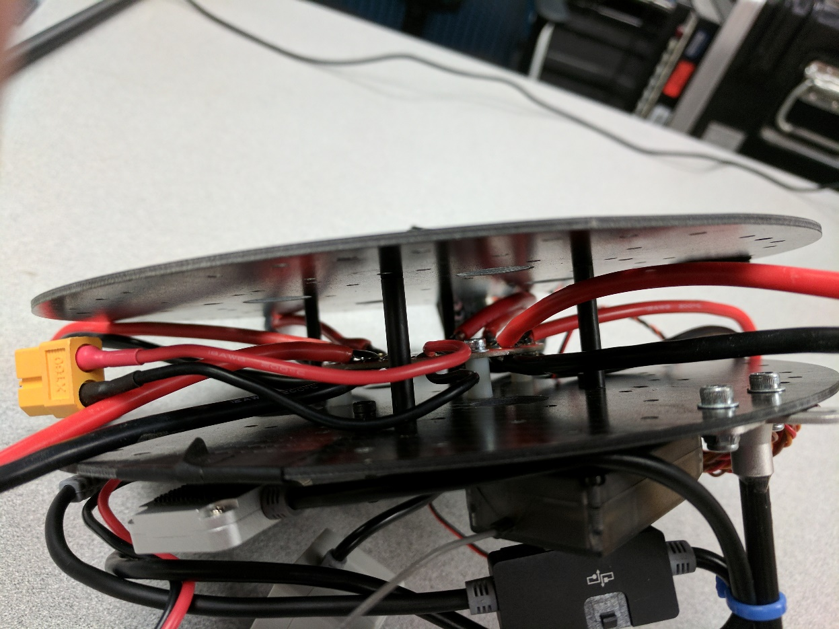
Center Plate

Slide 12
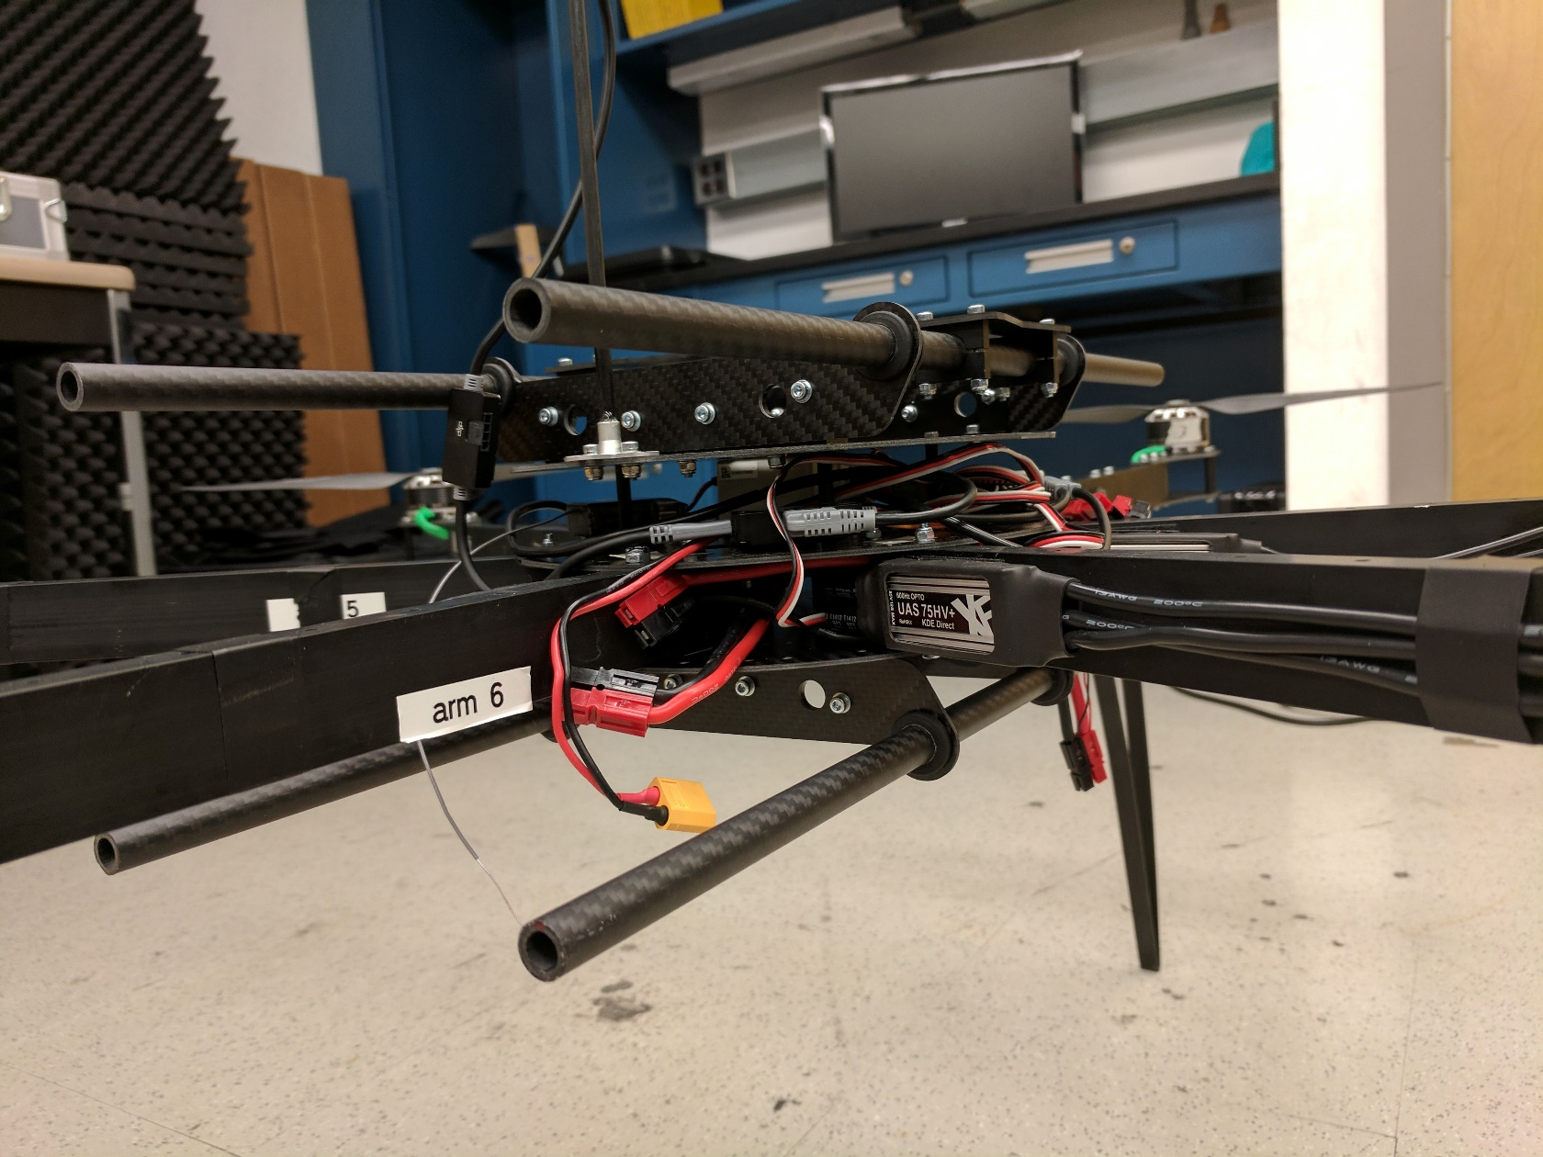
Completed Center Plate

Slide 13
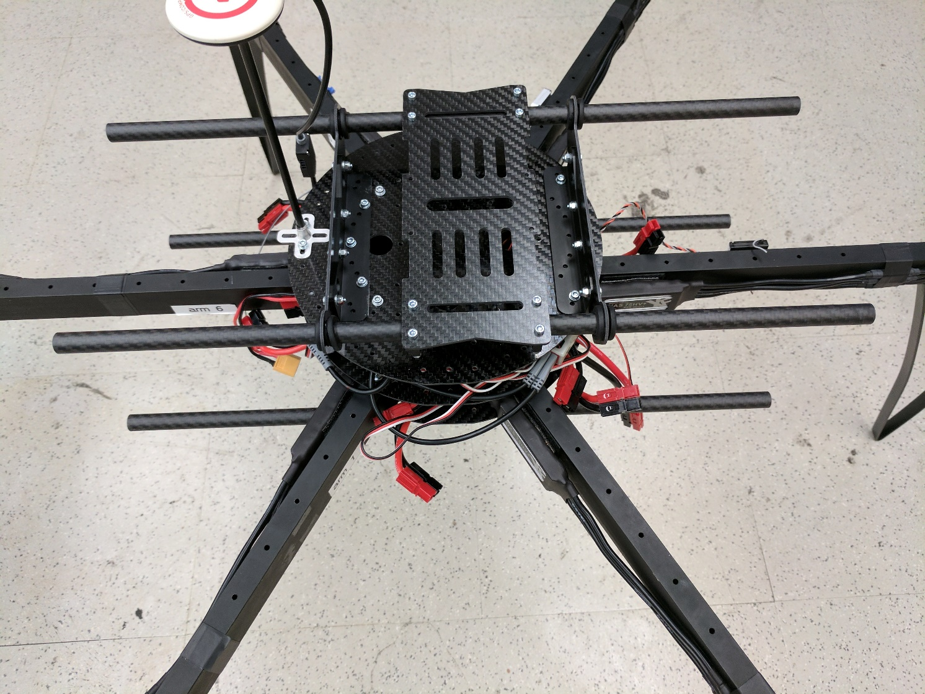
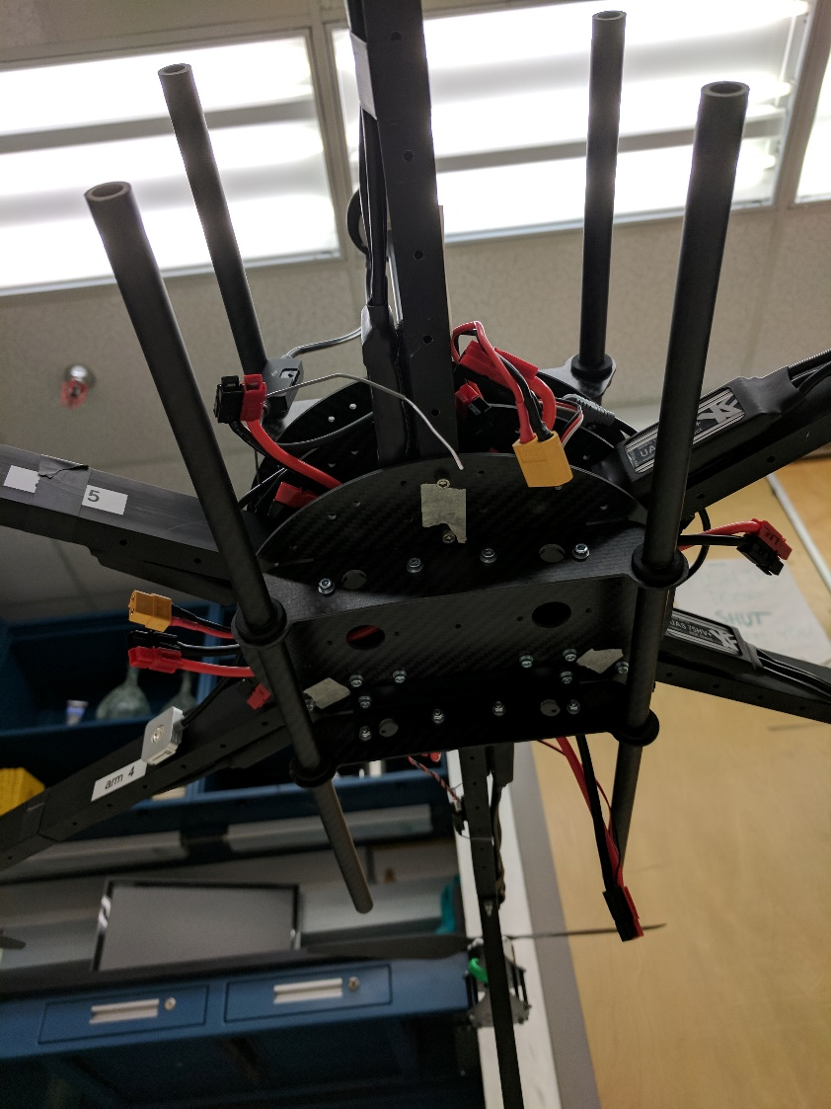
Battery Tray and Gimbal Mount

Slide 14
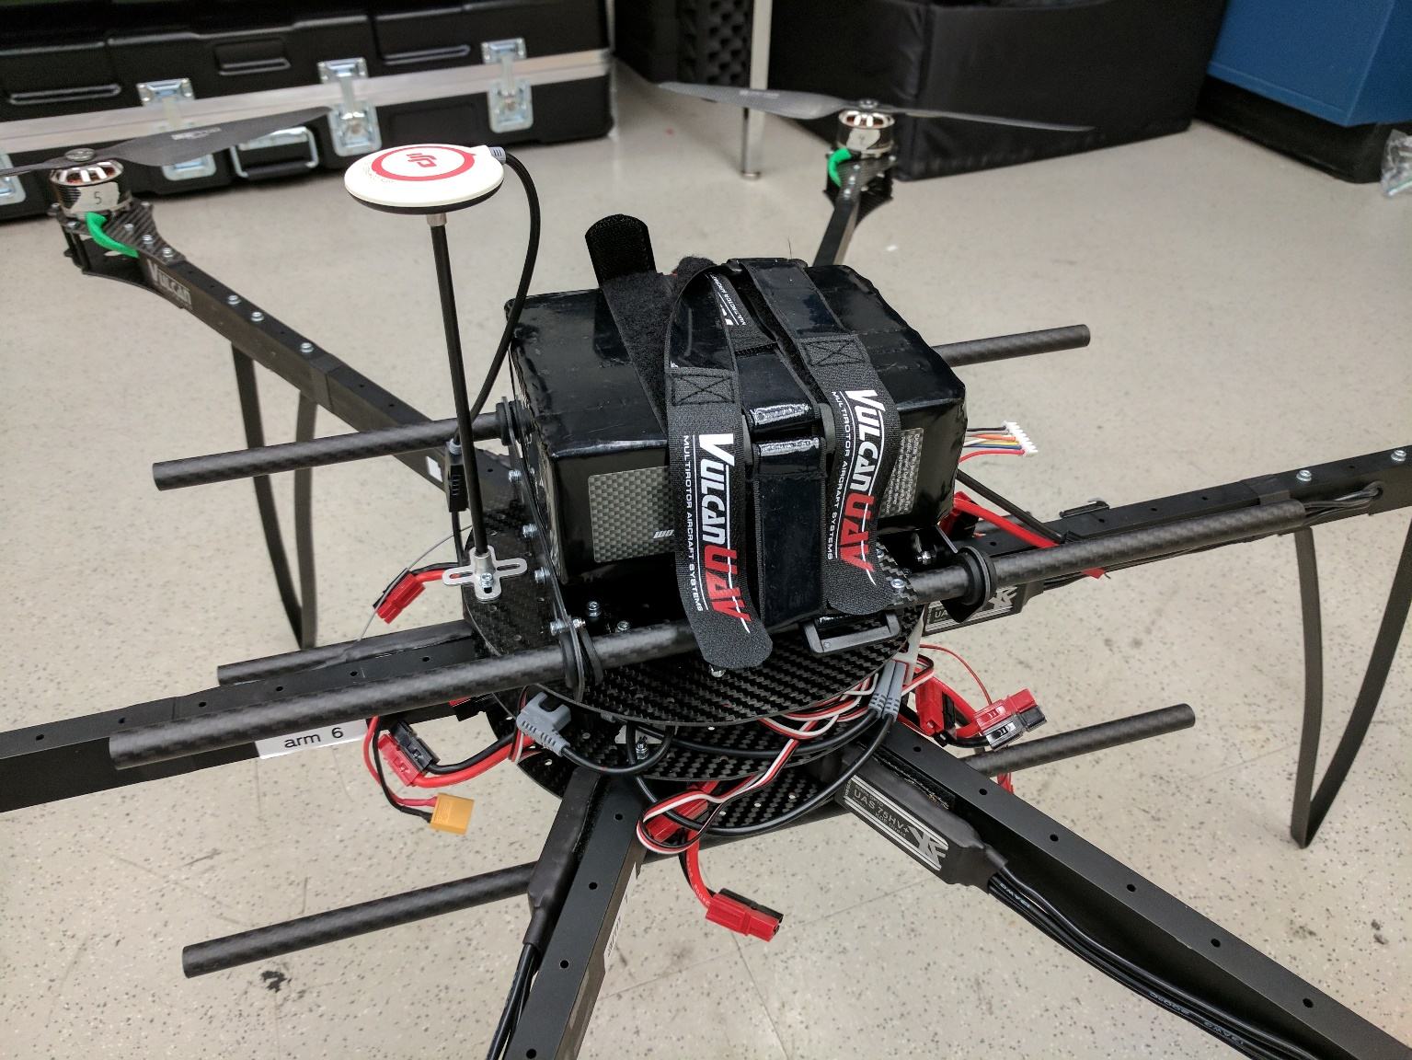
Mounted Battery

Slide 15
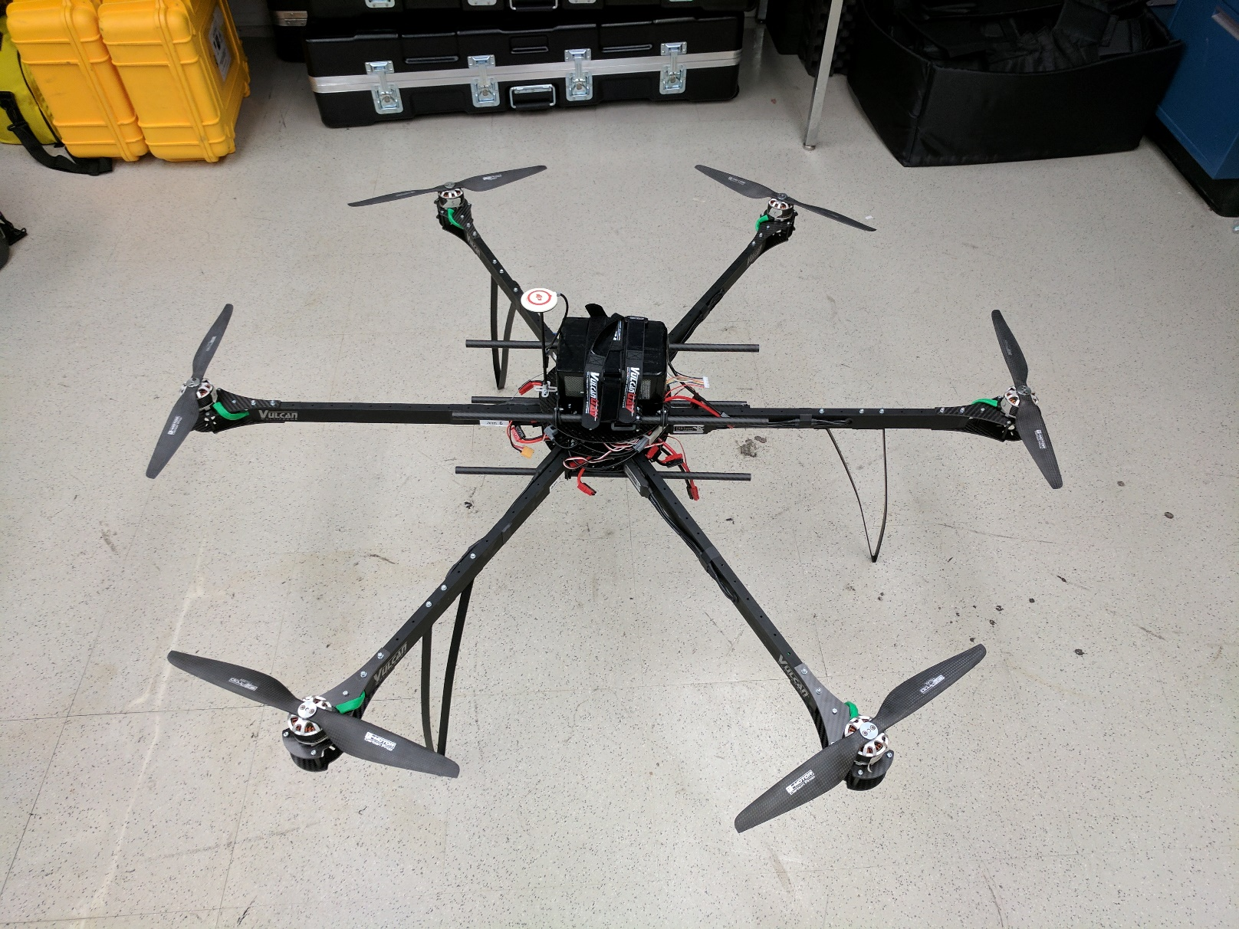
Finished Product

Slide 16
Future Activities
Selection of 3-axis aerial gimbal.
Integration of FLIR with gimbal and visual spectrum camera.
Programming of Raspberry Pi 3.
Installation of Amimon Connex HD video transmitter.

Slide 17
Acknowledgements
Dr. Christopher Hamilton
Stephen Scheidt
University of Arizona Lunar and Planetary Laboratory
Arizona Space Grant Consortium

Slide 18
Thank You

